Slide 1
TCL SCRIPTING

Slide 2
Course Objectives
By the end of this course, you will be able to
● Explain Tcl scripting
● Identify Tcl uses and strengths
● Write simple Tcl scripts
● Demonstrate the Tcl usage for EDA scripting

Slide 3
Why Should I Use Tcl?
● Productivity
● Portability
▪ MS Windows, UNIX variants, Macintosh, OpenVMS, BeOS, etc.
● Availability
▪ Download, use, modify, and re-distribute without royalties
● Interfacing between the tools
▪ Can bridge incompatible interfaces, platforms, and distant locations
● Many available extensions
▪ GUI programming (Tk, Tix, BLT, Togl, etc.)
▪ Interaction with command-line applications (expect)
▪ Database (OraTcl), object-oriented programming (incr_Tcl)

Slide 4
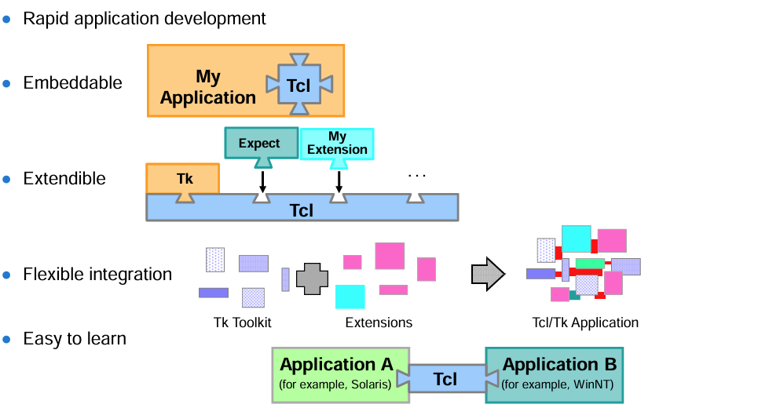
Tcl: Main Features

Slide 5
Tcl in EDA
Tcl is the standard EDA scripting language. Typical uses:
● Simulation, synthesis and test automation scripting
● Data analysis and visualization
● Design flow integration
● Netlist conversion, analysis and hacking
● Linking incompatible tools running on different platforms
● Scripting front-ends for command-line based applications
● IP core customization scripting
● Automated testbenches, regression testing, HW/SW co-verification
● Portable system demonstrators/applications
● Project/EDA system administration (installation, backup, etc.)

Slide 6
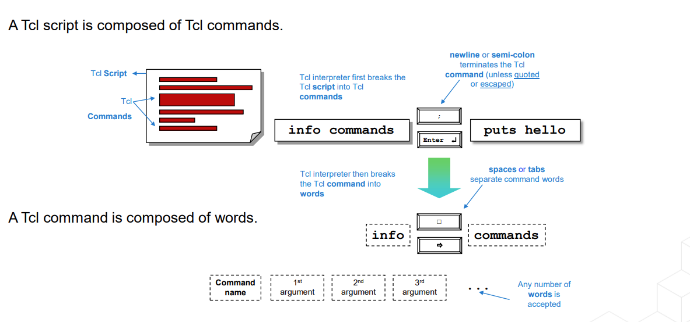
Tcl Commands

Slide 7
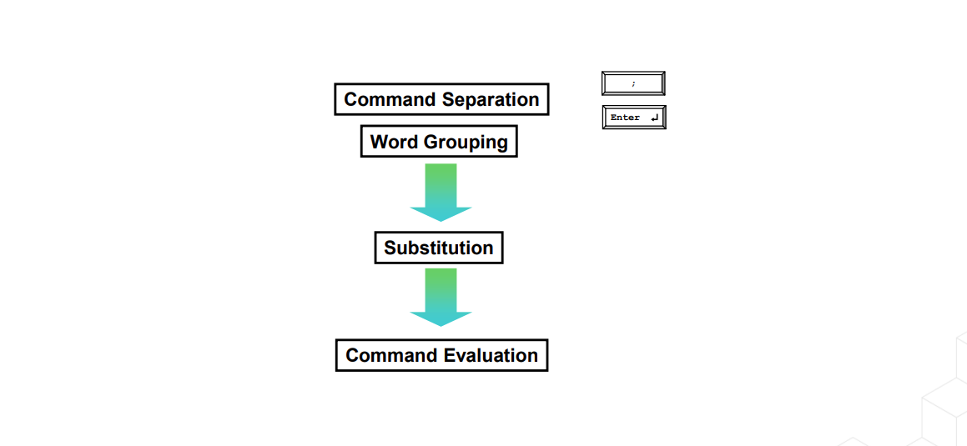
Tcl Script Processing Summary

Slide 8
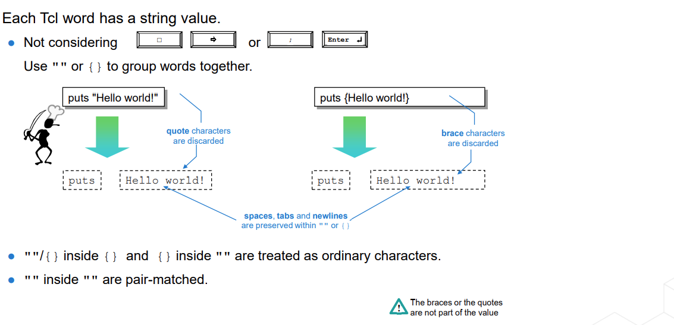
Word Grouping with "" and {}

Slide 9
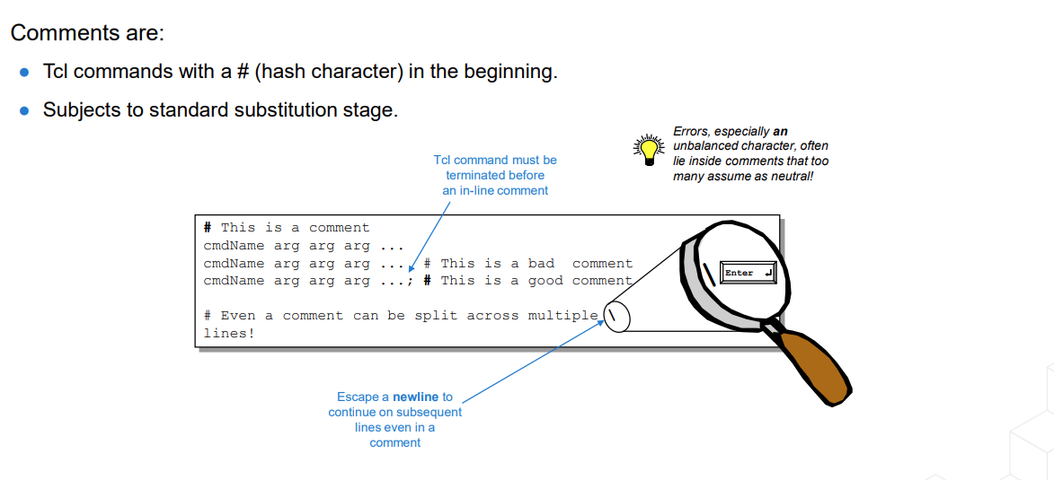
Tcl Comments

Slide 10
Example of Comment Parsing
The Tcl interpreter also parses comments:
proc p1 {} {
puts {# I wanted to write this}
puts {I've changed my mind}
}
p1
% source comment.tcl

Slide 11
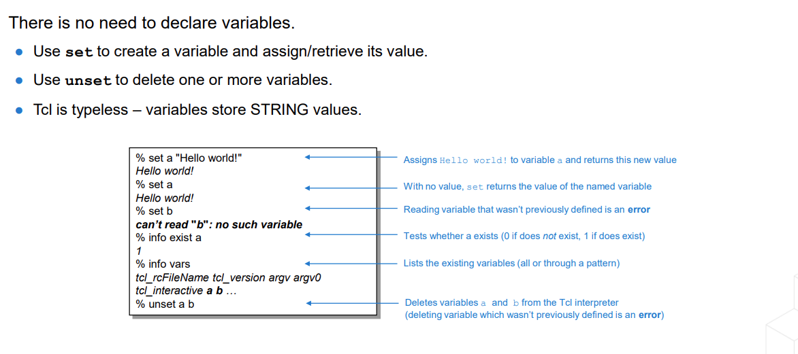
Variables

Slide 12
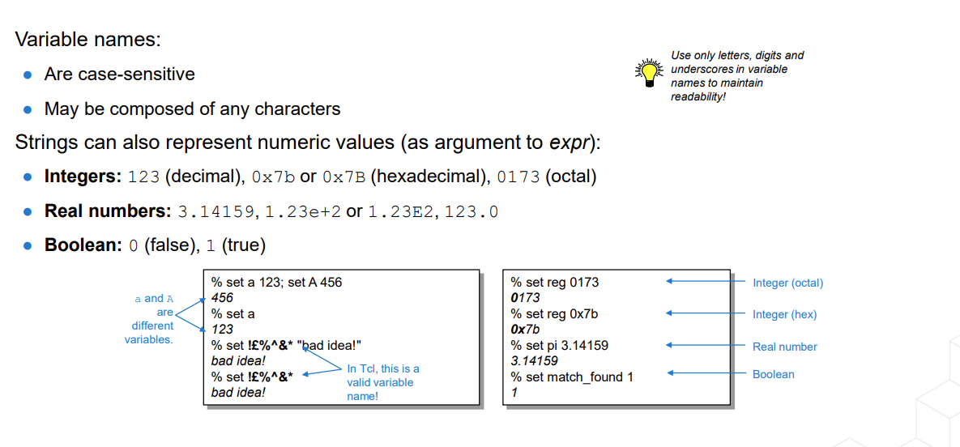
Variable Names and Values

Slide 13
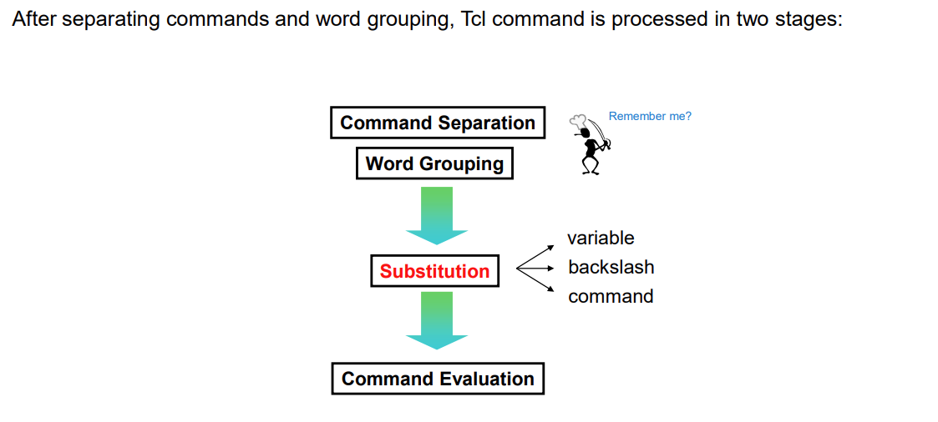
Tcl Scripting Processing Step: Substitution

Slide 14
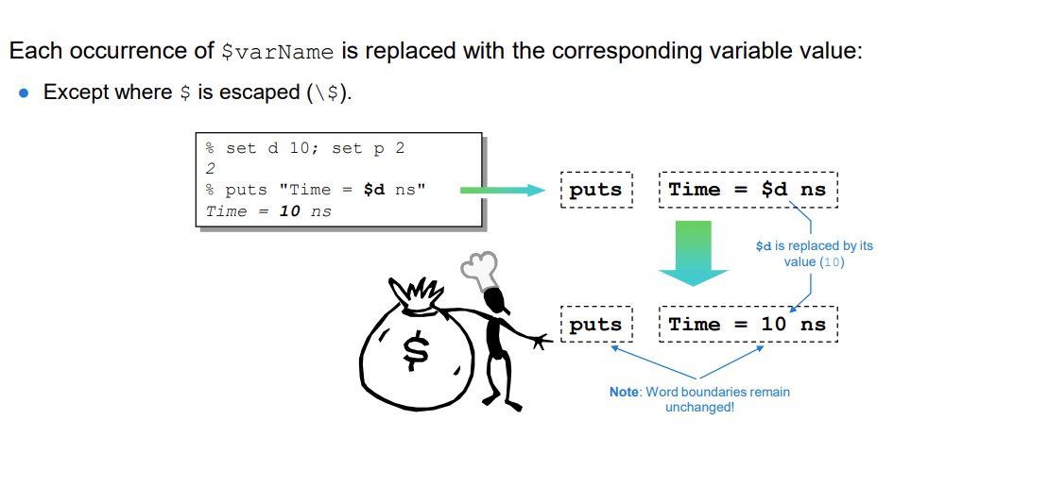
Variable Substitution ($)

Slide 15
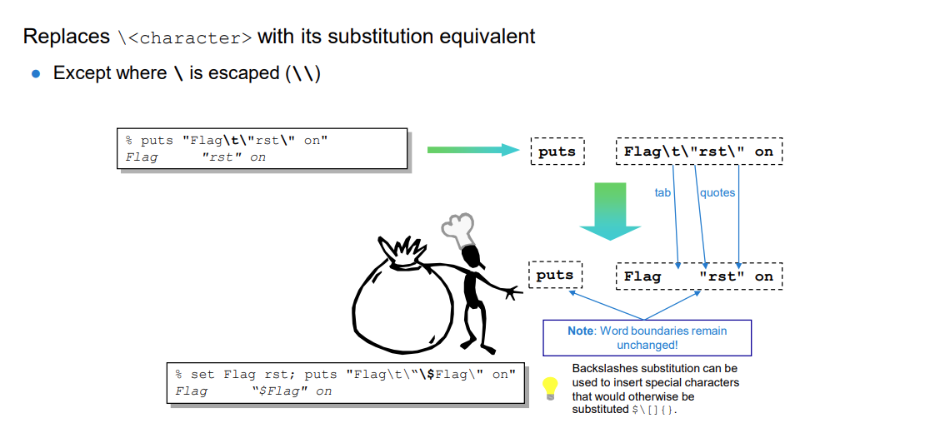
Backslash Substitution (\)

Slide 16
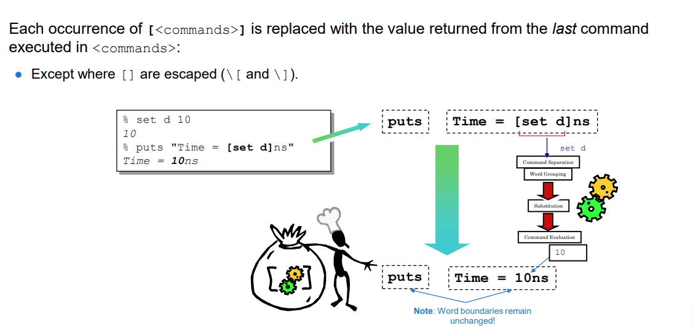
Command Substitution ([])

Slide 17
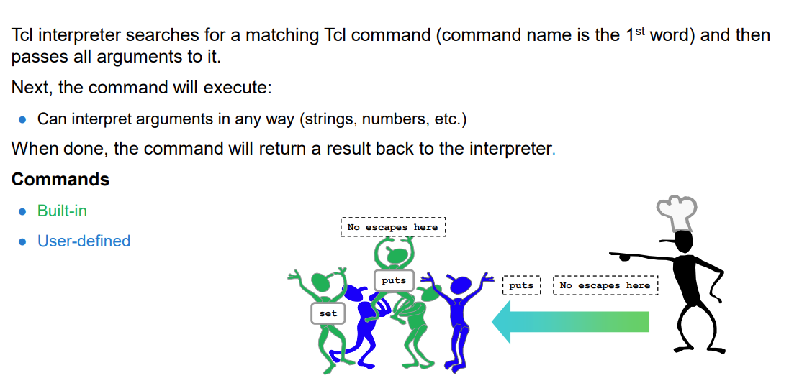
Command Evaluation

Slide 18
Example of Command Substitution ([])
% set d 10
% set e 12
% puts "Time = [set d; set e] ns"
Answer = ?

Slide 19
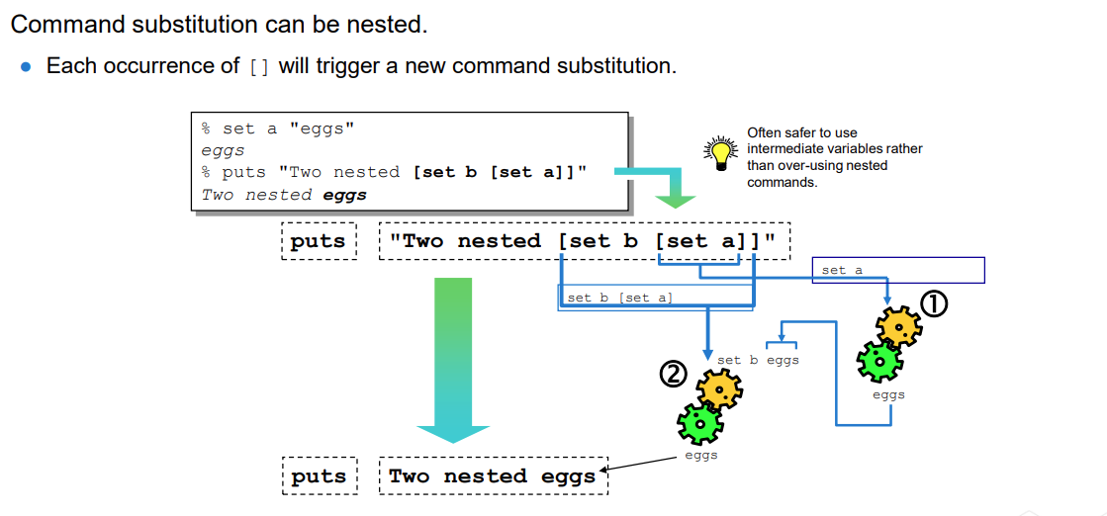
Nested Command Substitution

Slide 20
Example of Command Evaluation
set a 10
set b "{$a}\{ #[set c 14]"
puts "$b"
What is the value stored in b?
1. 10{10}{□
2. {□#14
3. {10}{□#[set□c□14]
4. $a{□#14
5. {10}{□#14
6. {$a}\{□#[set□c□14]
7. {$a}{□#14
8. This will generate a syntax error!

Slide 21
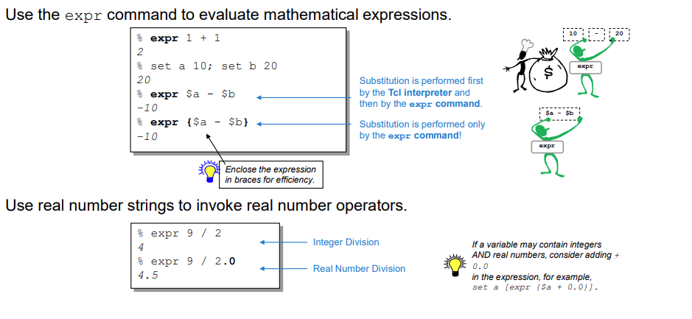
Tcl as a Calculator

Slide 22
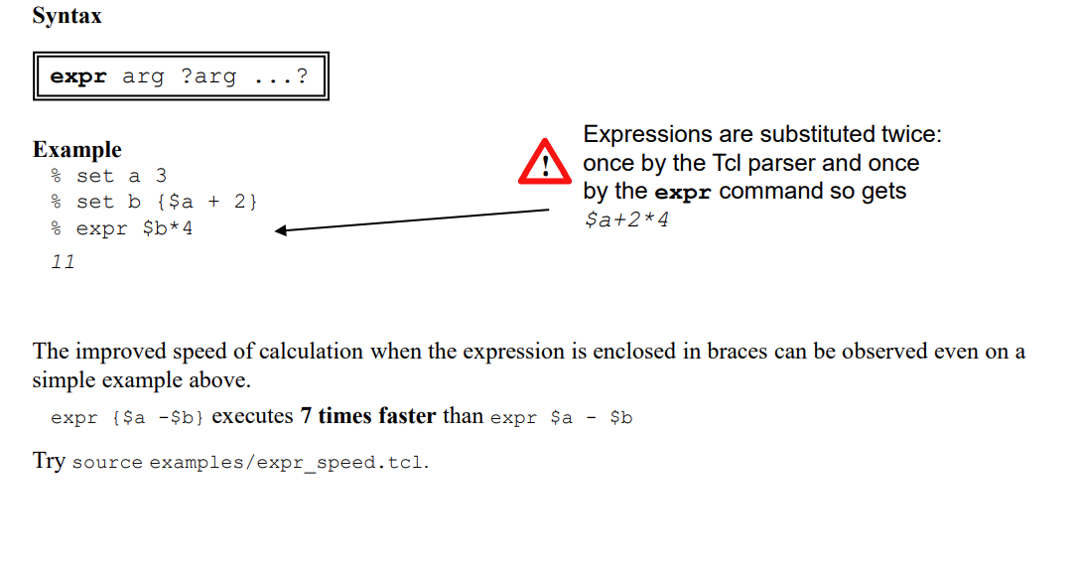

Slide 23
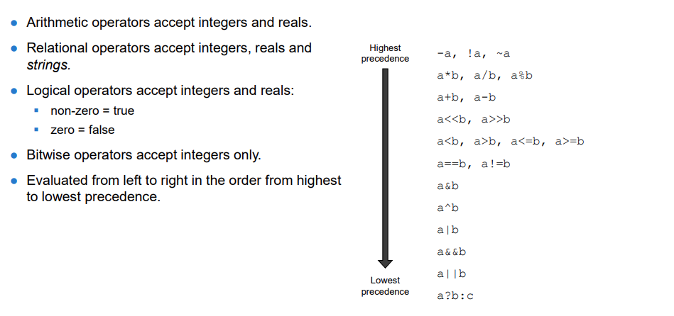
Operators

Slide 24
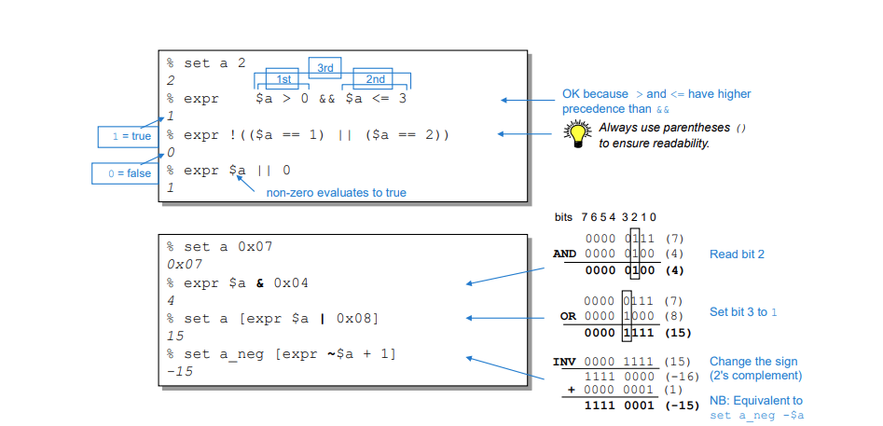
Examples: Tcl Operators

Slide 25
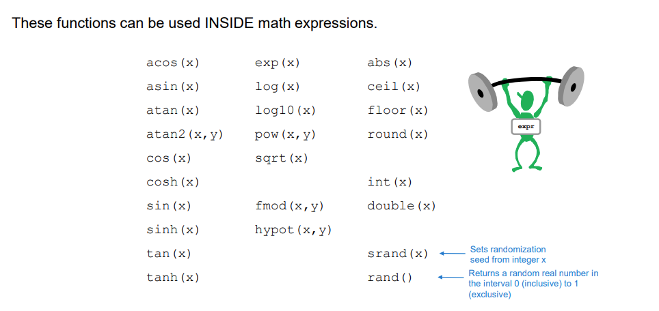
Mathematical Functions: Randomization

Slide 26
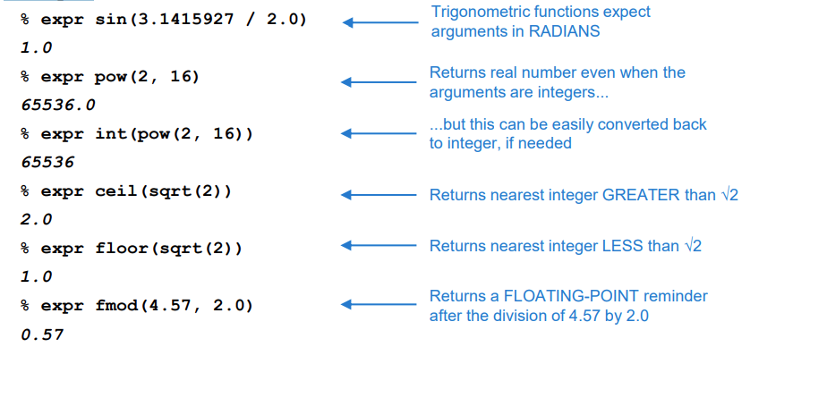
Examples of Mathematical Functions

Slide 27
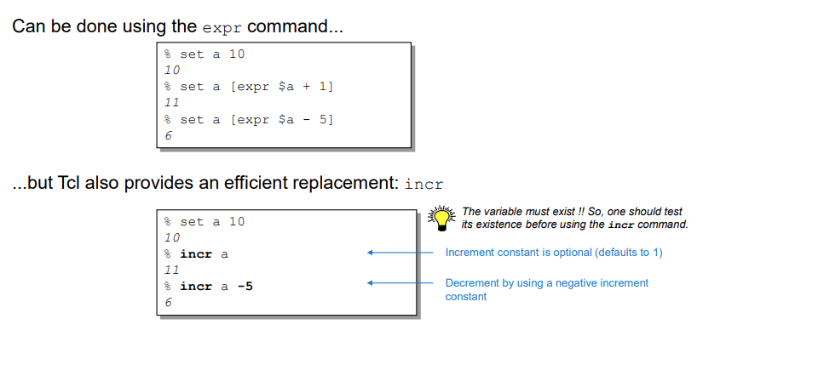
Incrementing and Decrementing

Slide 28
Example: Incrementing
Syntax
incr varName ?increment?
Examples
% set x 2; if {[info exists x]} {incr x} else {set x 0}
3
% unset x; if {[info exists x]} {incr x} else {set x 0}
0

Slide 29
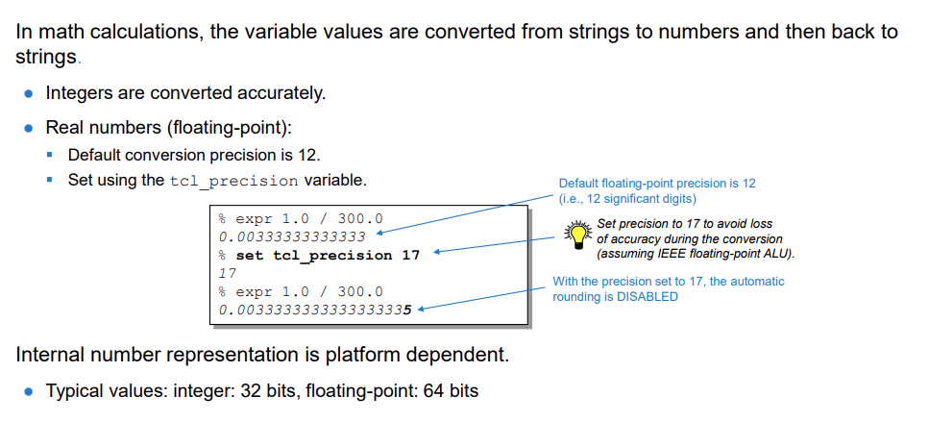
Numerical Accuracy

Slide 30
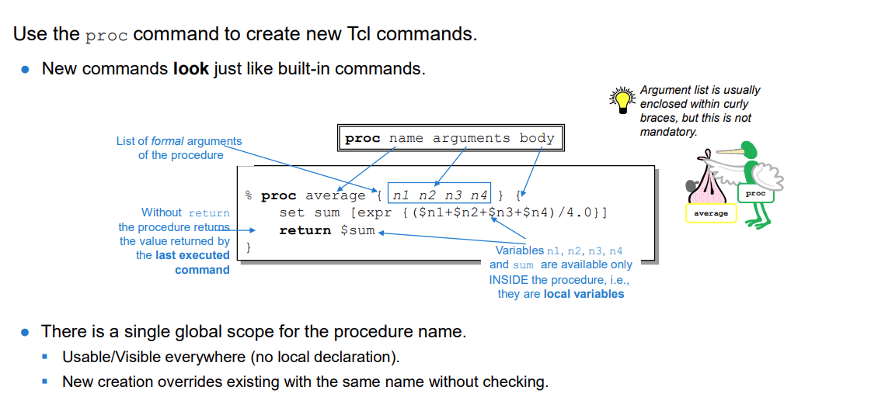
Basic Procedures

